Slide 1
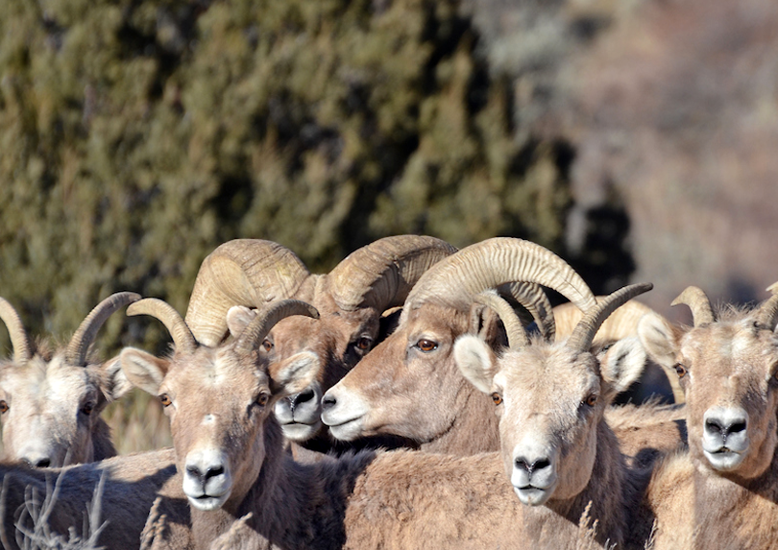
Bighorn sheep, 4 adult females (slender horns) and 2 adult males (thick horns)

Slide 2
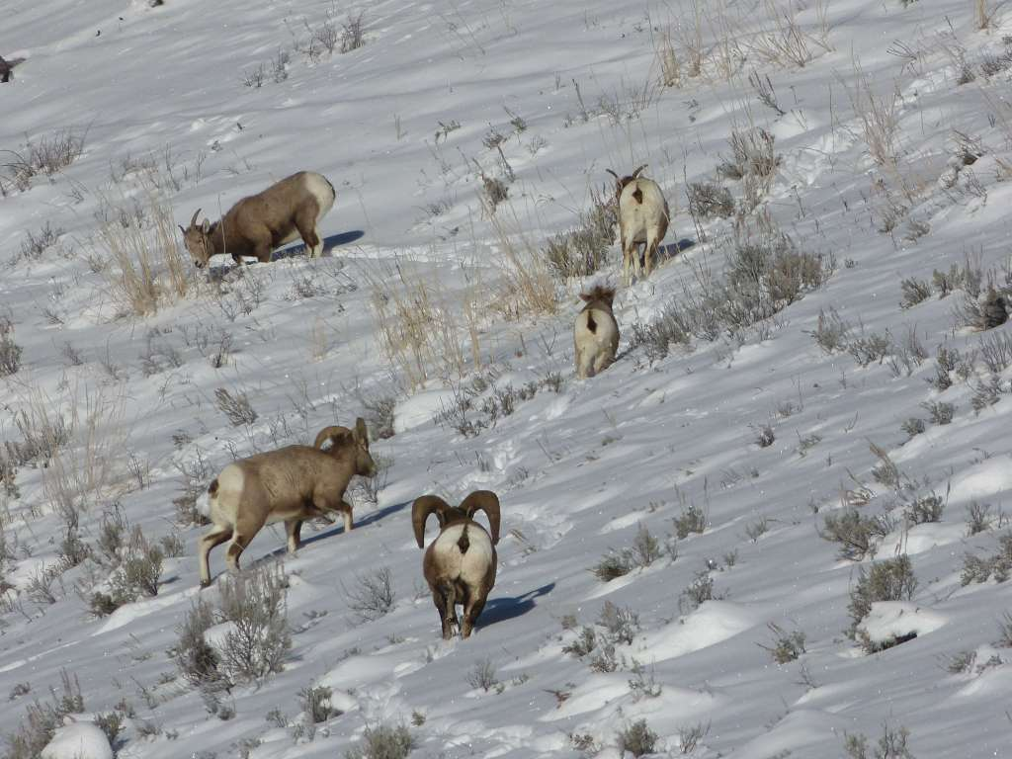
Bighorn sheep, 2 adult females (slender horns) 2 adult males (thick horns) and one juvenile. Juveniles look like adults in winter, just smaller.

Slide 3
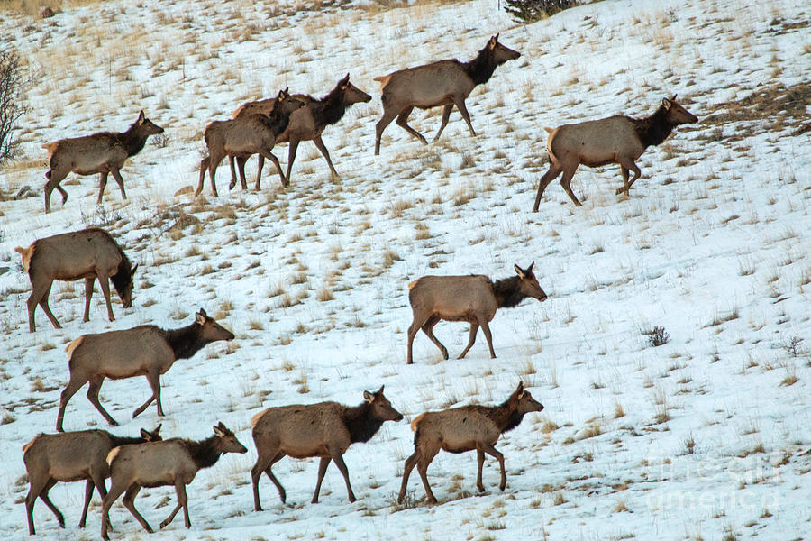
Elk, 8 adult females and 4 juveniles. Juveniles look like adults in winter, just smaller.

Slide 4
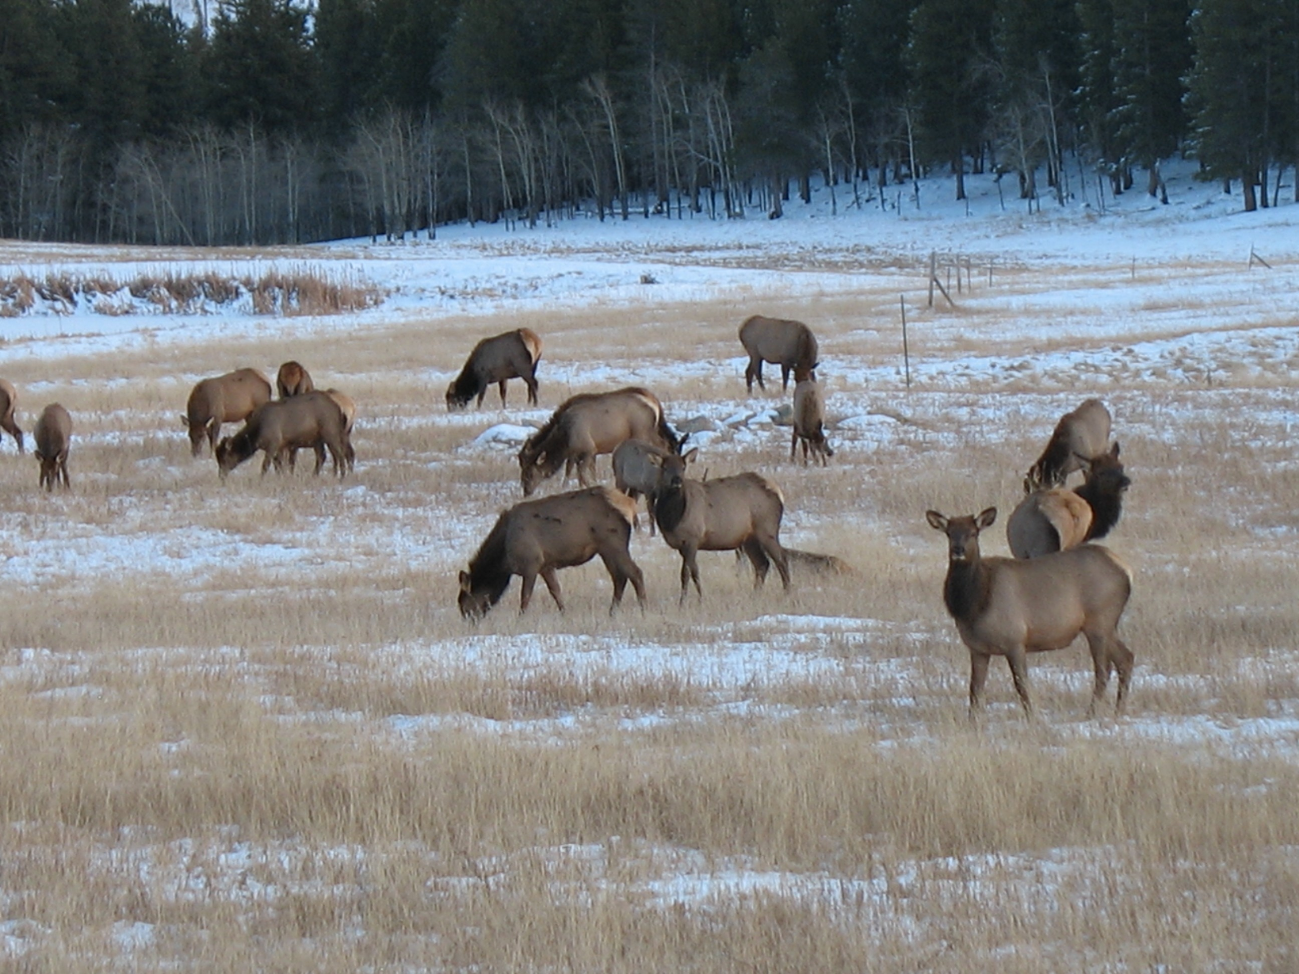
Elk, 18 total. 8 Unknowns, 9 adult females and 1 juvenile.

Slide 5
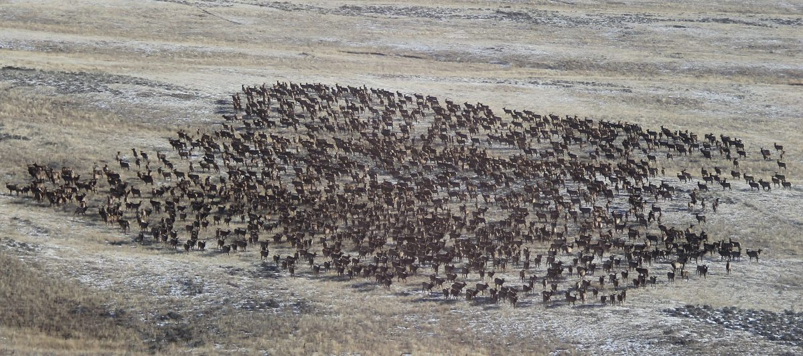
Elk, >500, all unknown

Slide 6
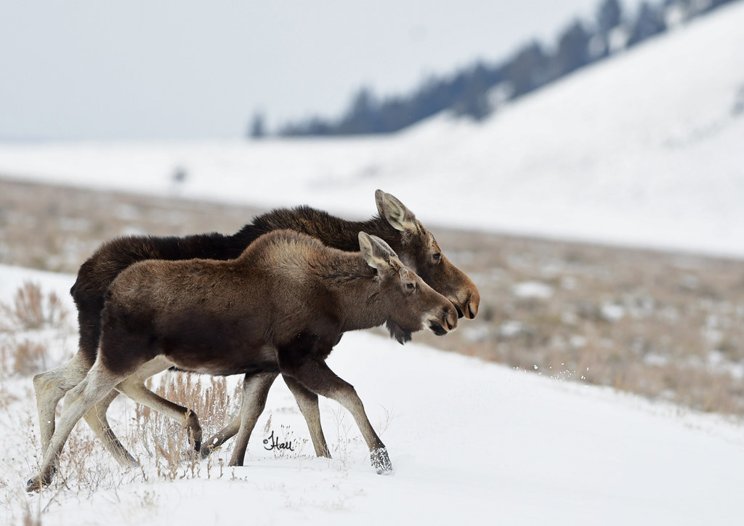
Moose, 1 adult female, 1 juvenile. Juveniles look like adults in winter, only smaller.

Slide 7
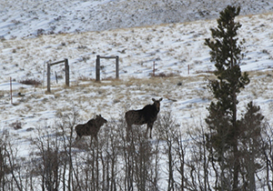
Moose, 1 adult female, 1 juvenile. Juveniles look like adults in winter, only smaller.

Slide 8
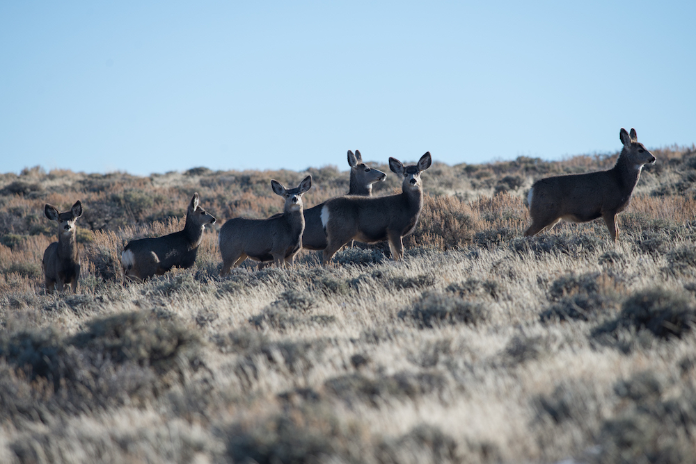
Mule Deer, 1 adult female, 1 unknown, 4 juveniles

Slide 9
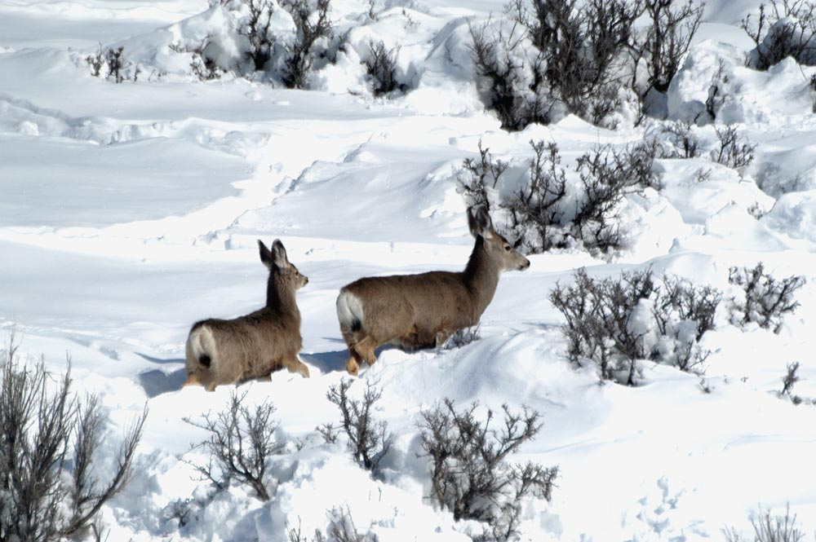
Mule Deer, 1 adult female, 1 juvenile

Slide 10
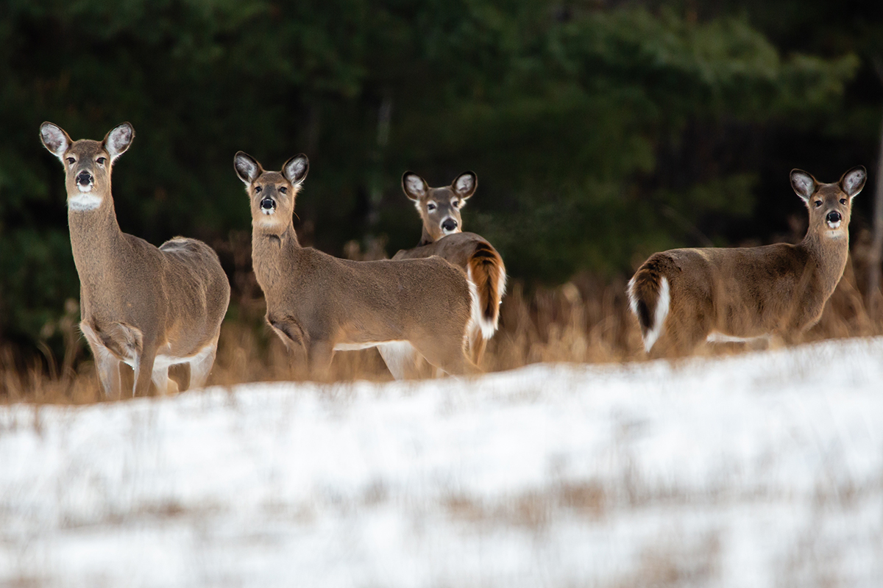
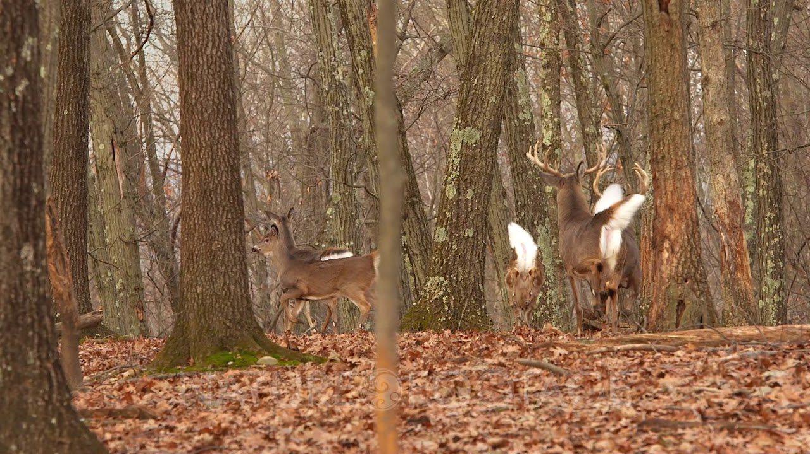
White Tailed deer, 2 adult female, 2 juvenile

Slide 11
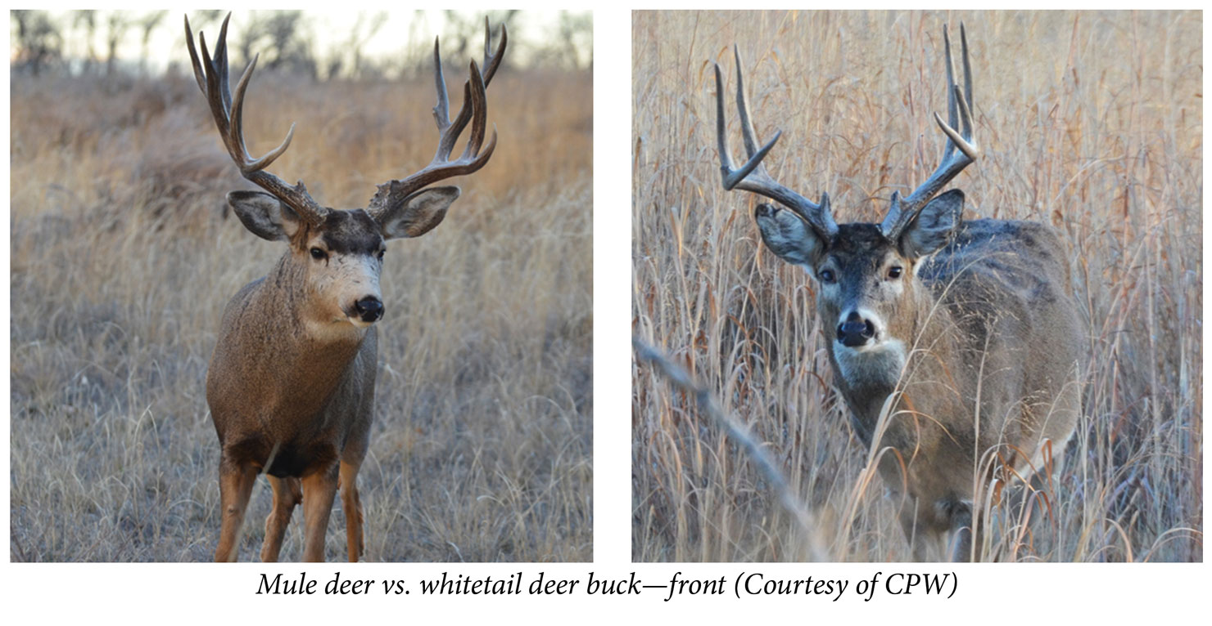

Slide 12
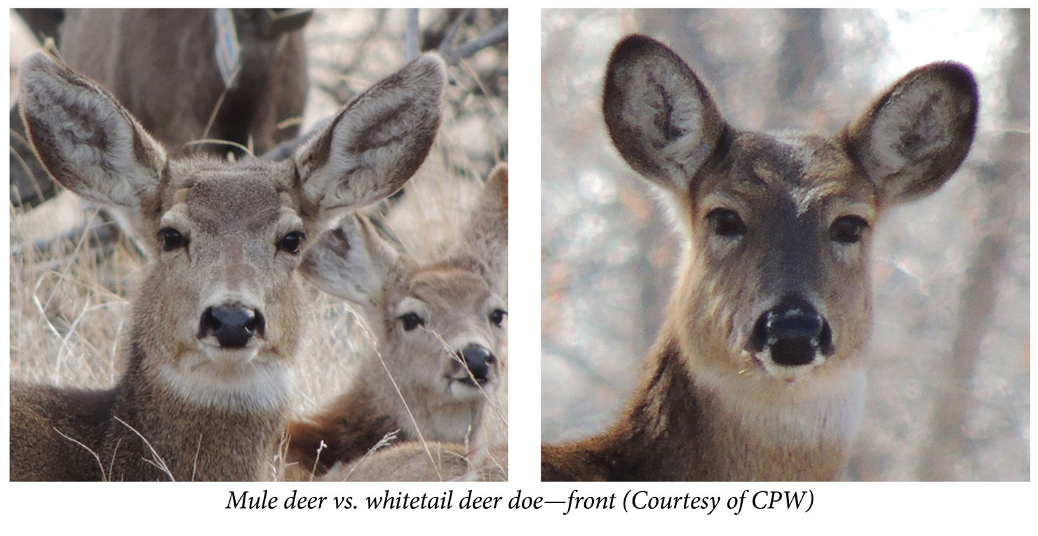

Slide 13
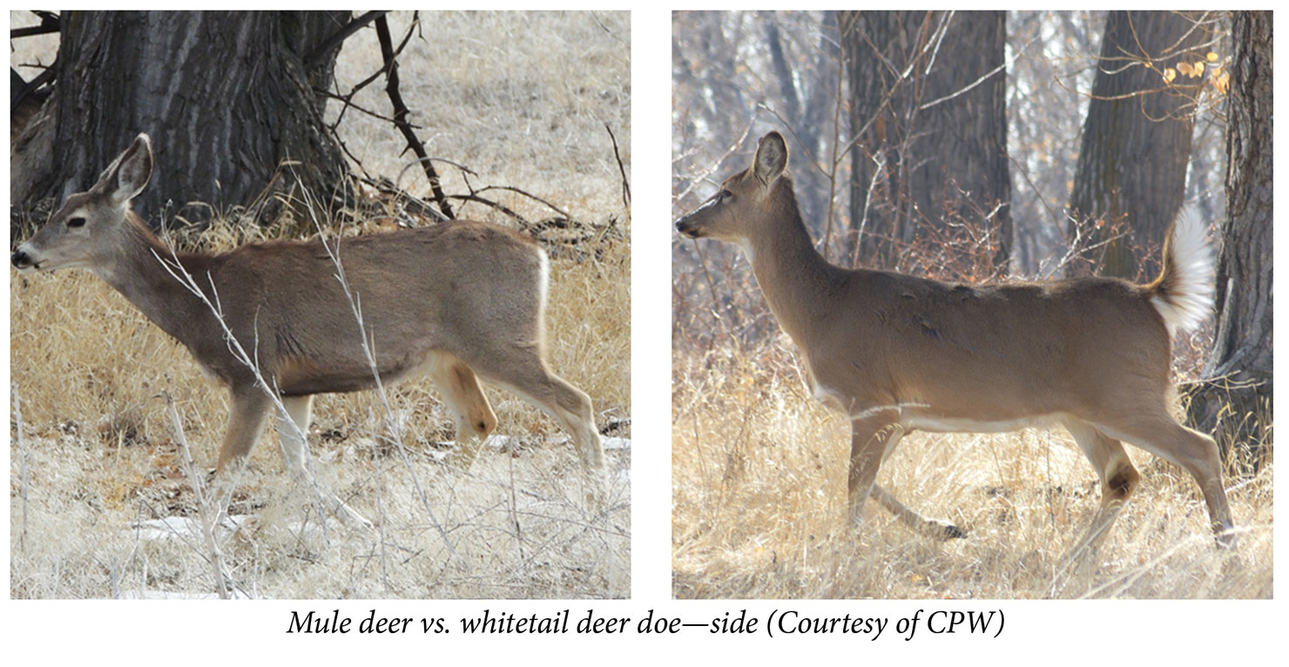

Slide 14
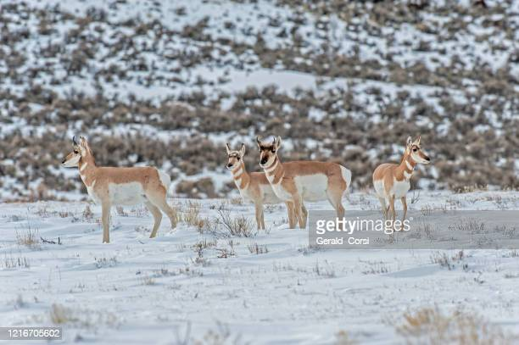
Pronghorn 2 adult male, 2 female.

Slide 15
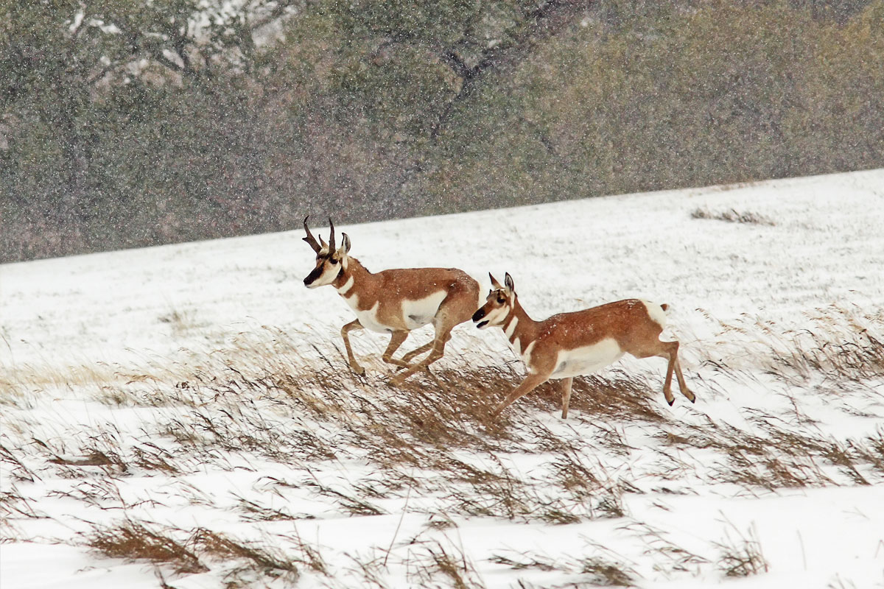
Pronghorn 1 adult male (large horns), 1 female (small horns).

Slide 16
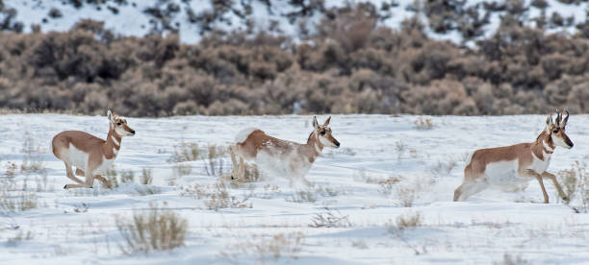
Pronghorn 1 adult male, 2 female.

Slide 17
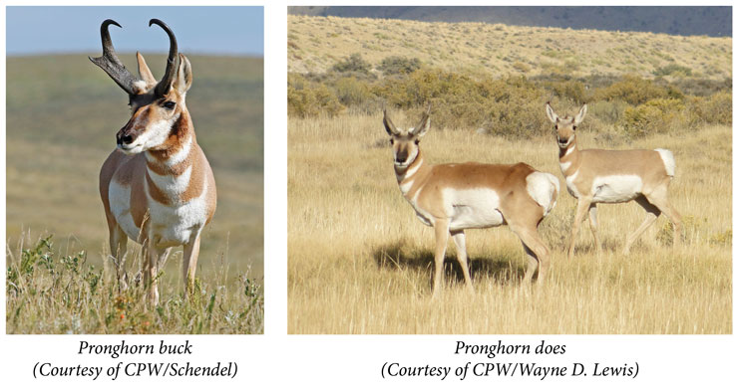

Slide 18
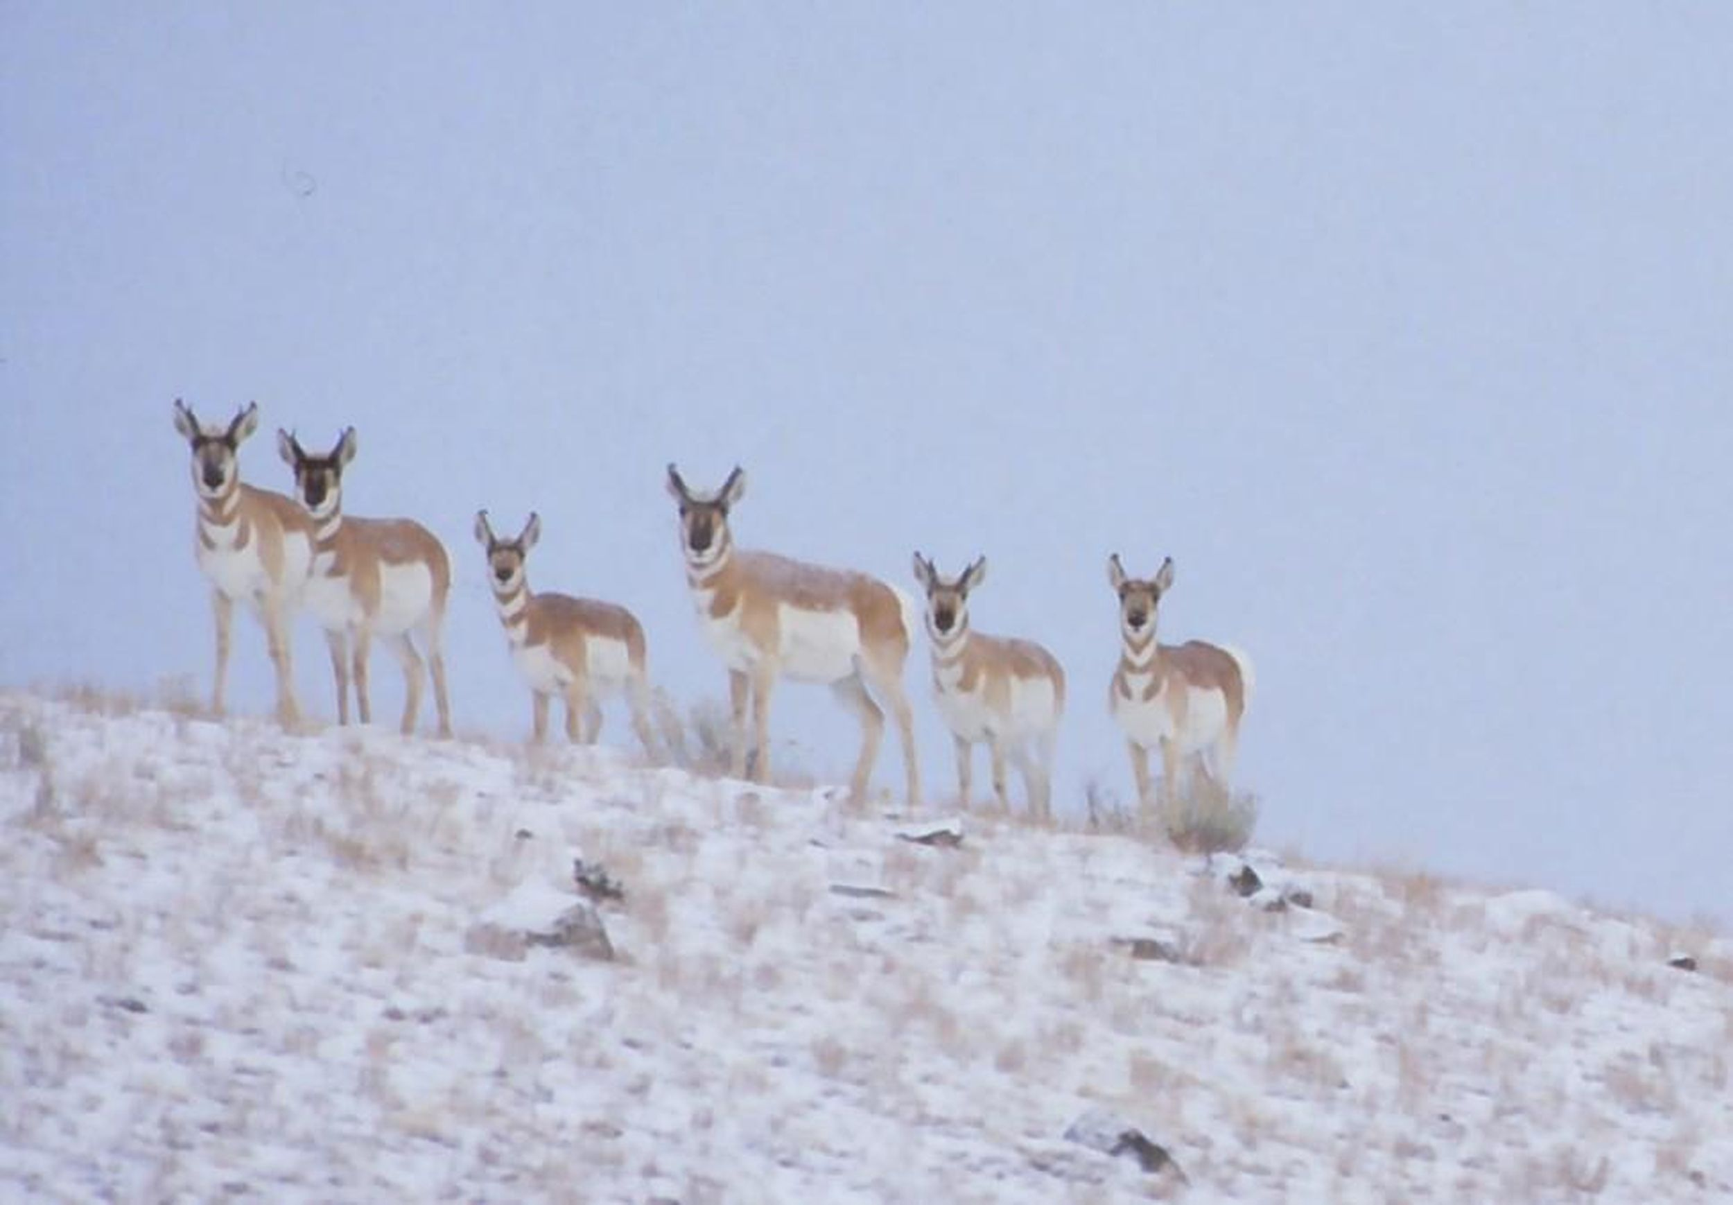

Slide 19
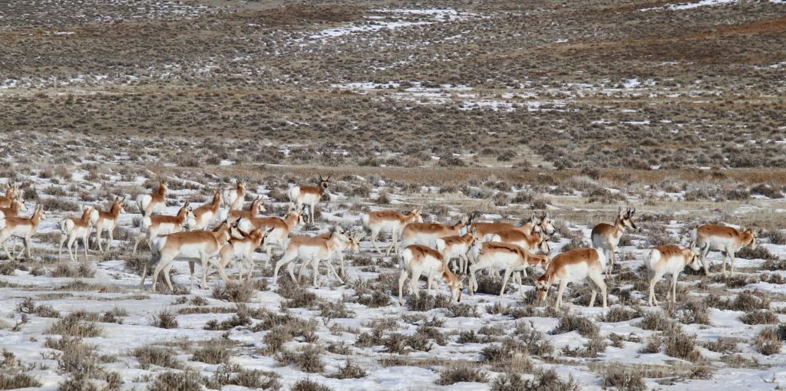
Pronghorn 29 total. 6 adult male, 23 Unknowns.

Slide 20
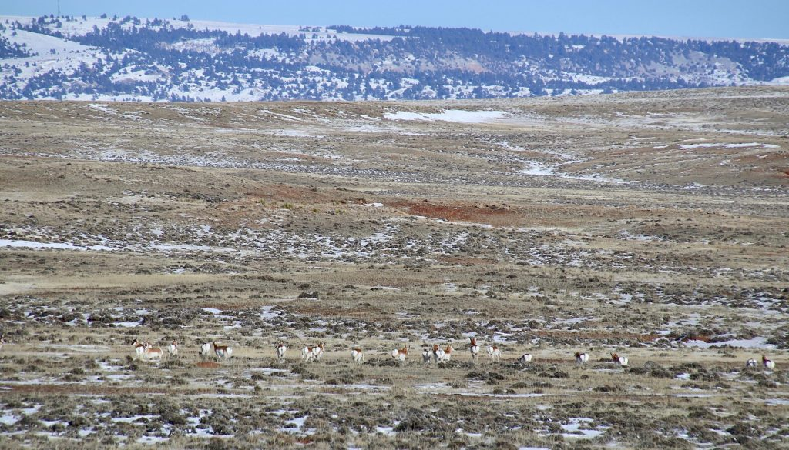
Pronghorn 20 Unknowns

Slide 21
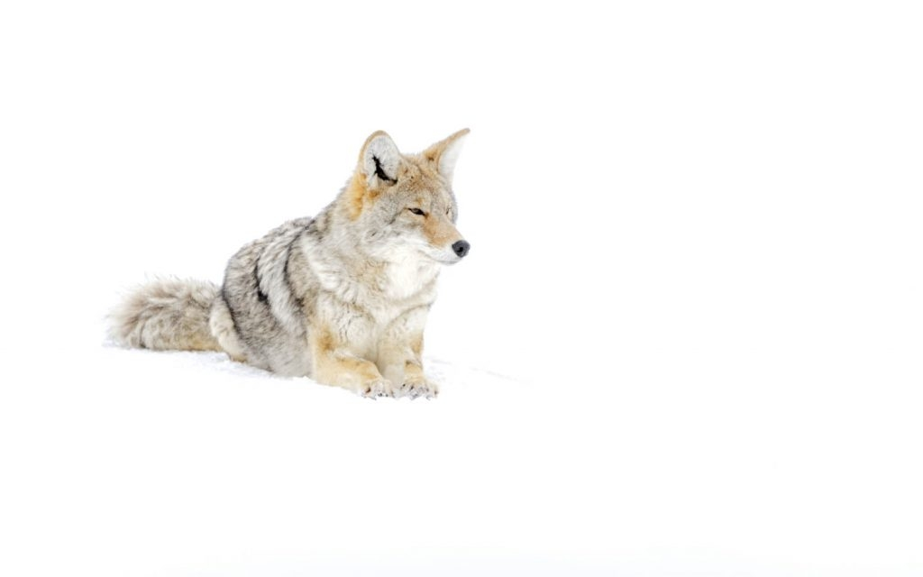
Coyote, 1 adult

Slide 22
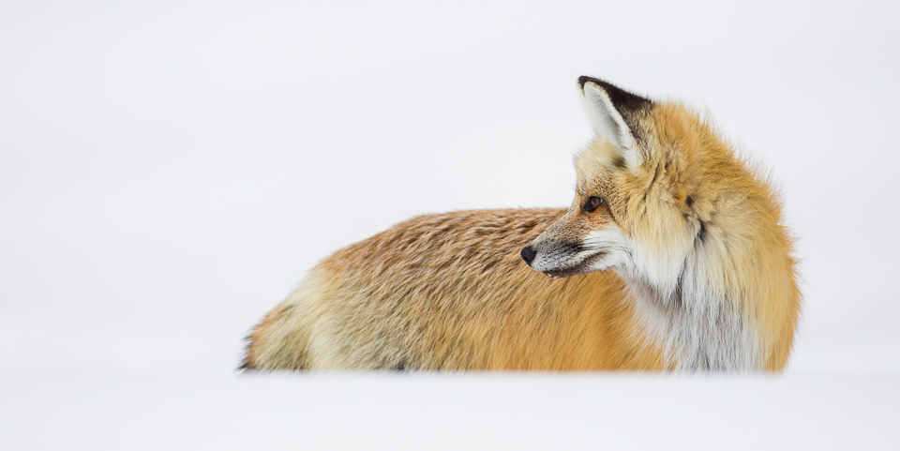
Red fox, 1 adult

